Slide 1
SAPTHAGIRI COLLEGE OF ENGINEERING
(Affiliated to Visvesvaraya Technological University, Belagavi & Approved by AICTE, New Delhi.)
Department of Information Science & Engineering
Mobile Application Development Lab
18CSMP68
Installation of Android studio
BY
Prof. SUDARSANAN D
Assistant Prof, Dept of ISE

Slide 2
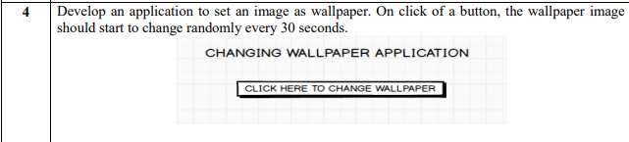

Slide 3
Step 1:[copy the image from desktop to res folder inside
DOWNDLOAD 5 WALLPAPER IMAGES AND STORE IT INTO THE FOLDER(DESKTOP)
NOTE imag1.jpg, imag2.jpg …….
THEN COPY THE IMAGES AND STORE INTO THE ANDROID STUDIO IN FOLLOWING LOCATION
RES FOLDER → DRAWABLE FOLDER INSIDE
STEP 2: [DESGIN ACTIVITY FORM]
GOTO PALETTE→COMMON→TextView drag and drop
Change relevant Attribute properties
text=Change wallpaper Application
Textsize=24sp
..
..
Change Wallpaper Application
Apply constraint to all sides to fix the position

Slide 4
Step 3:[select button]
GOTO PALETTE→BUTTON→BUTTON drag and drop
Change Wallpaper Application
Change attribute value
Id=btn_wall
Text=Click Here to change wallpaper
Click Here to change wallpaper
Apply constraint to all sides to fix the position

Slide 5
Step 4:[Implementing java code]
package com.example.wallpaper; import androidx.appcompat.app.AppCompatActivity; import android.app.WallpaperManager; import android.graphics.BitmapFactory; import android.os.Bundle; import android.view.View; import android.widget.Button; import java.io.IOException; import java.util.Random; import java.util.Timer; import java.util.TimerTask; public class MainActivity extends AppCompatActivity implements View.OnClickListener { Button btn; boolean running; //running state or not running state int[] ia=new int[]{R.drawable.imag1,R.drawable.imag2,R.drawable.imag3,R.drawable.imag4,
R.drawable.imag5}; //create an array to store all image to retrieve one by one

Slide 6
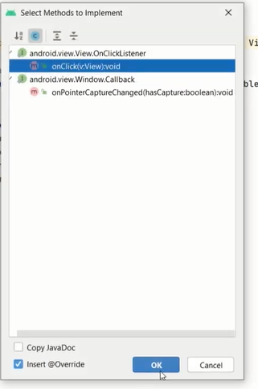

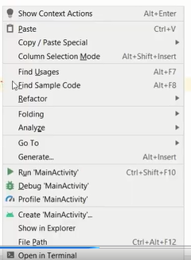

ok
onClick(View view)
btn
MOBILE DEV
xml
click
ACTION
setOnclickListener
this
@Override protected void onCreate(Bundle savedInstanceState)
{ super.onCreate(savedInstanceState); setContentView(R.layout.activity_main); btn = (Button) findViewById(R.id.btn_wall); btn.setOnClickListener(this); } @Override public void onClick(View view) { if (!running) { //check running state or stop state
new Timer().schedule(new Mytimer(), 0, 3000); //select schedule of three parameter ie task , delay, period running=true; } }
1
Right click create a method
2
2
Import
class

Slide 7
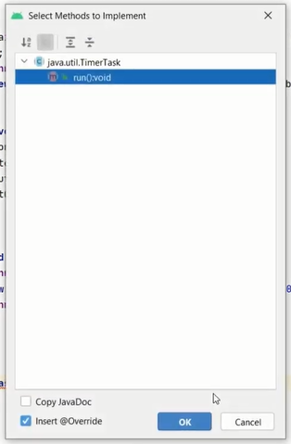

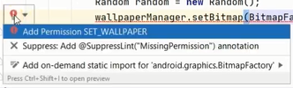
B
2
A
private class Mytimer extends TimerTask { @Override public void run() // After 30 seconds change another wall paper to use this run method
{ try { WallpaperManager wallpaperManager = WallpaperManager.getInstance(getBaseContext()); Random random = new Random(); wallpaperManager.setBitmap(BitmapFactory.decodeResource(getResources(), ia[random.nextInt(5)])); }
catch (IOException e) { } } } }
C
Getting current wallpaper from array ia using random o object

Slide 8
Output:

